Slide 1
MV FRAM Land of the Penguins Ushuaia – Antarctic Peninsula – Ushuaia 15 Jan. 17 – 27th Jan. 17

Slide 2
Antarctic Peninsula
18.01.16 – 24.01.16
Ushuaia
15.01.17 + 27.01.17

Slide 3
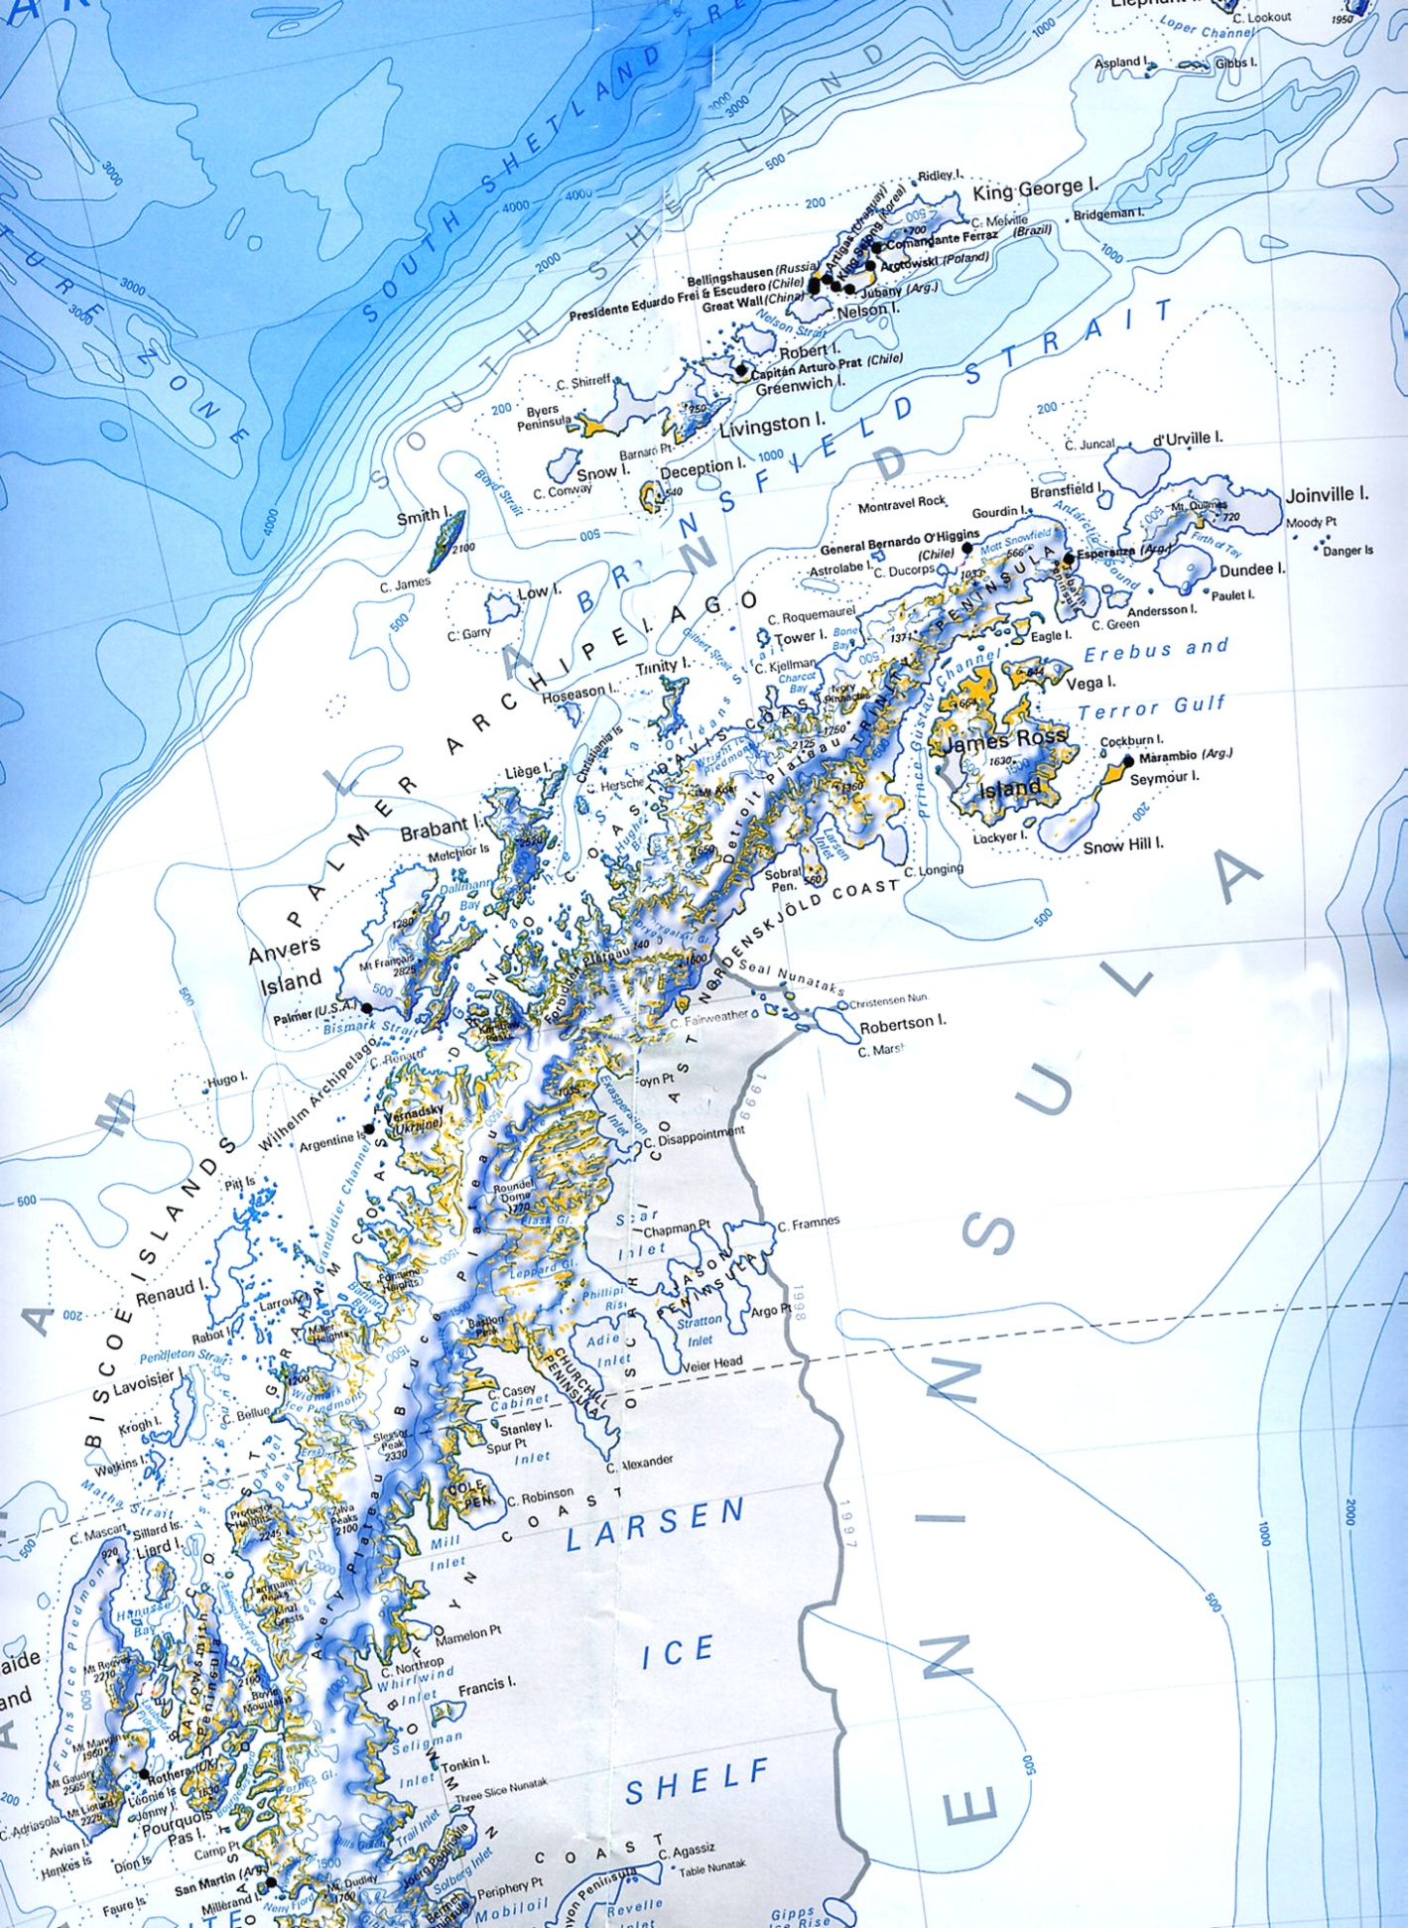
Land of the Penguins
18 Jan. Brown Bluff
19 Jan. Am: Half Moon
Pm: Yankee Harbor
20 Jan. Deception /whaler bay
21 Jan. Am: Whale cruising
Pm: Danco Landing
22 Jan. Am: Neko Harbor
Pm: Lemaire
23 Jan. AM: Petermann PM:Vernadsky
24 Jan. Port Lockroy
25 Jan. Drake passage
26 Jan. Drake passage
27 Jan. Ushuaia
Yankee Harbor
Half Moon
Deception Island
Brown Bluff
Port Lockroy
Danco
Lemaire Channel

Slide 4
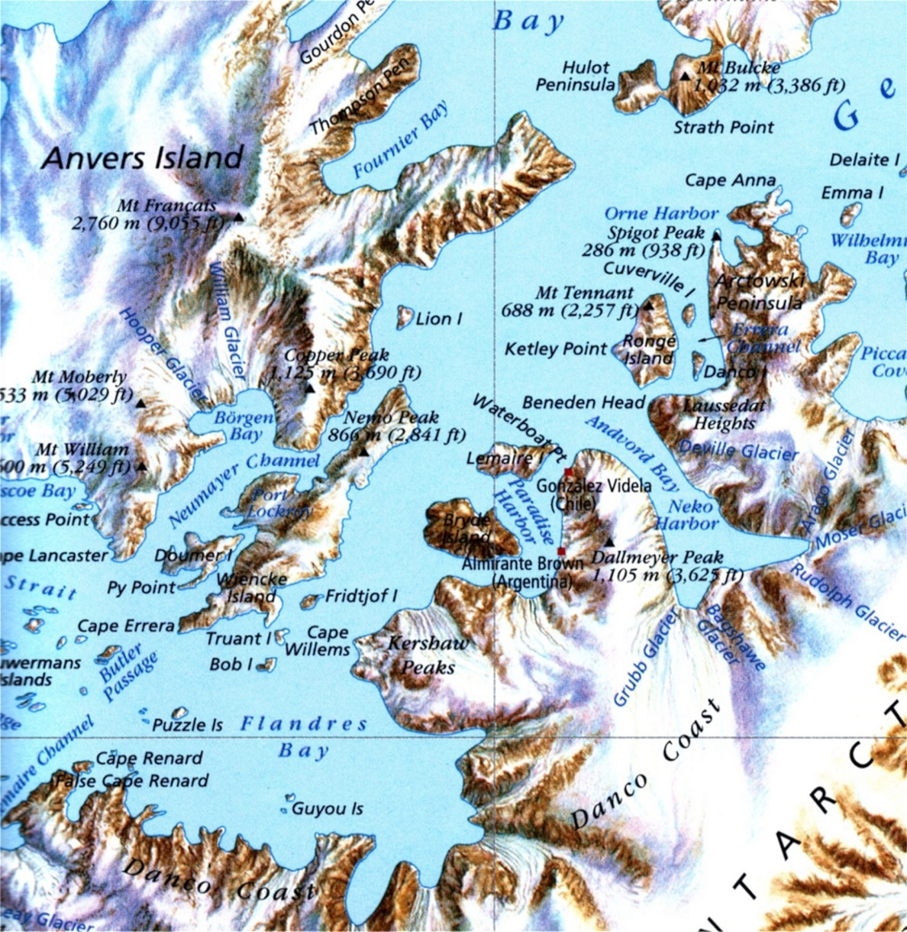
Danco
Neko Harbor
Port Lockroy
Lemaire Channel

Slide 5
Neko Harbour
Port Lockroy
Peterman Island
Lemaire Channel
Vernadsky Station

Slide 6
We hope you enjoyed your journey with Hurtigruten on Board MV Fram.

